Slide 1

Steel Industry Energy Consumption
Regression and Classification analysis

Slide 2
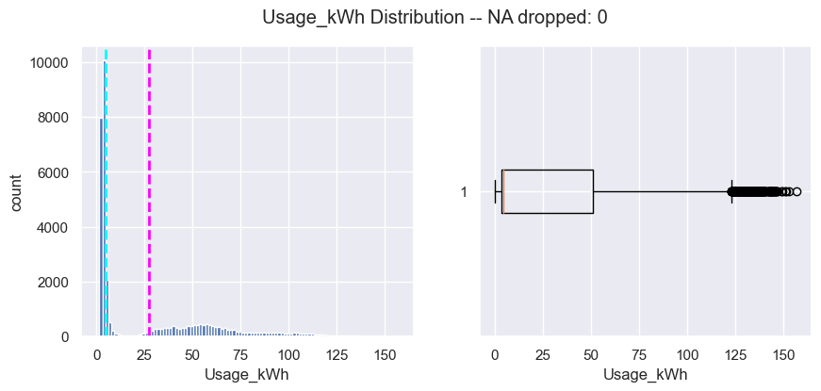
Important metrics: Usage_kWh
Bimodal distribution
Skewed significantly left
Plotting against other categories may reveal the nature of the bimodal distribution

Slide 3
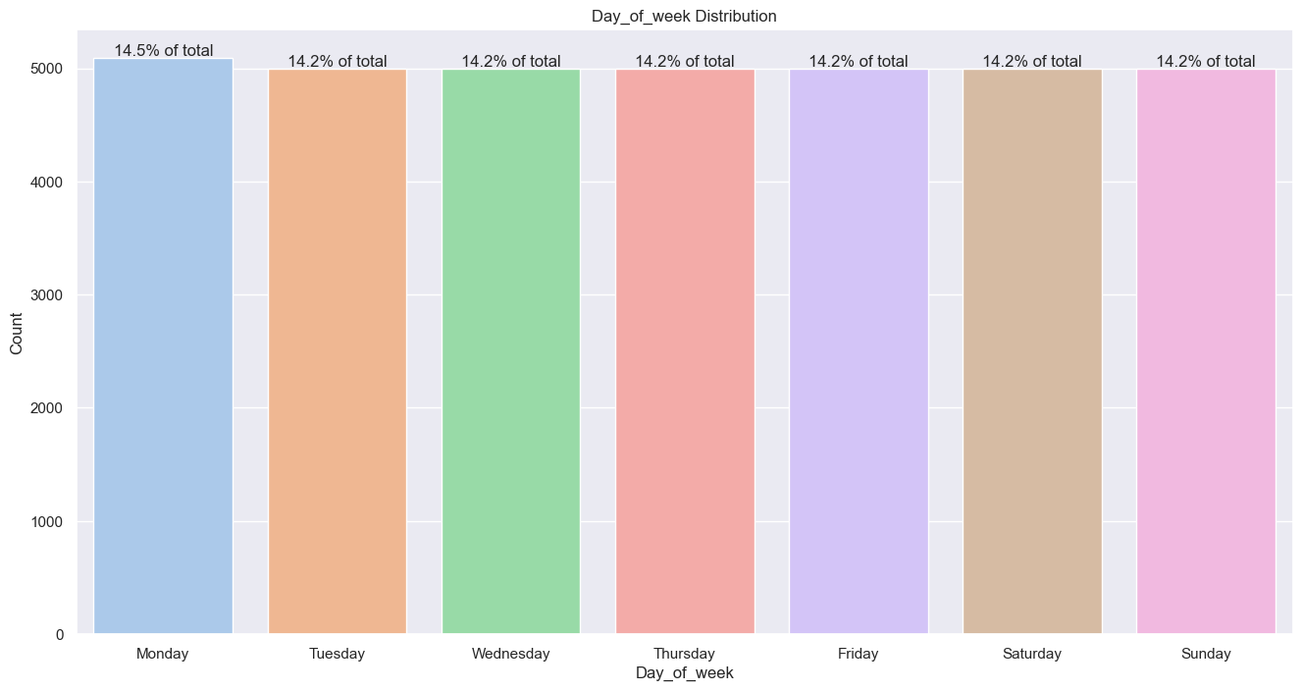
Consistency check: Day of week
Mondays have an odd percentage in the data, for data that includes dates ranging from over a single year, worth investigating if impactful

Slide 4
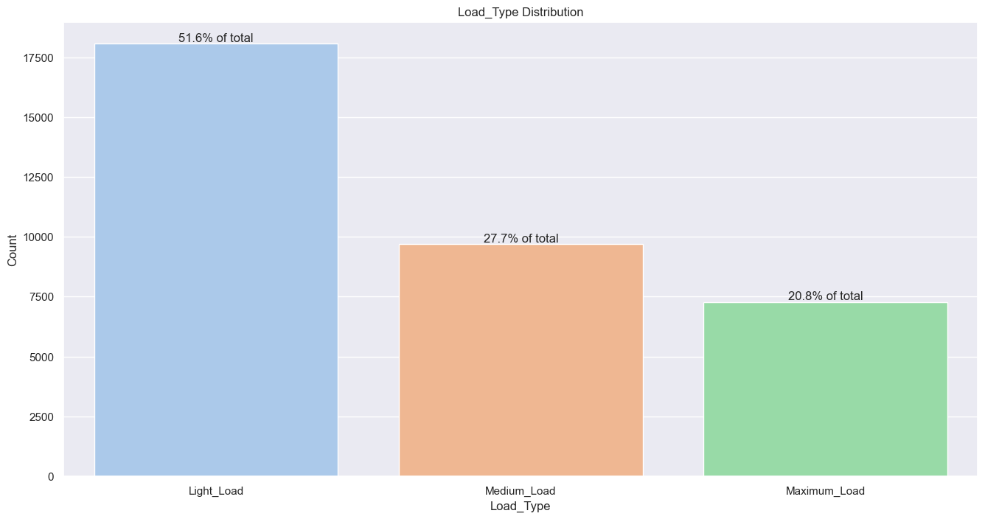
Consistency check: Load_Type imbalance
- Balance is imbalanced if we are using classification with Load_Type as a target column. Should use SMOTE, Borderline SMOTE, or ADASYN to process first.

Slide 5
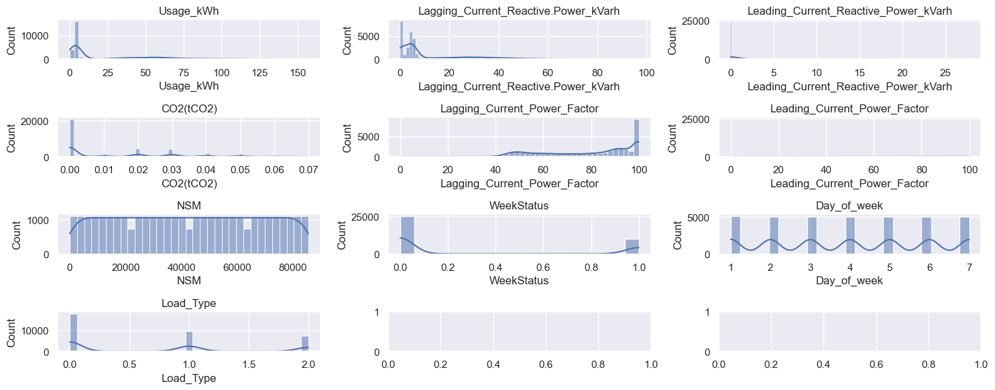
Important metrics: Total Distributions over features
Many are exponential in nature, and a logarithmic transform will reveal information

Slide 6
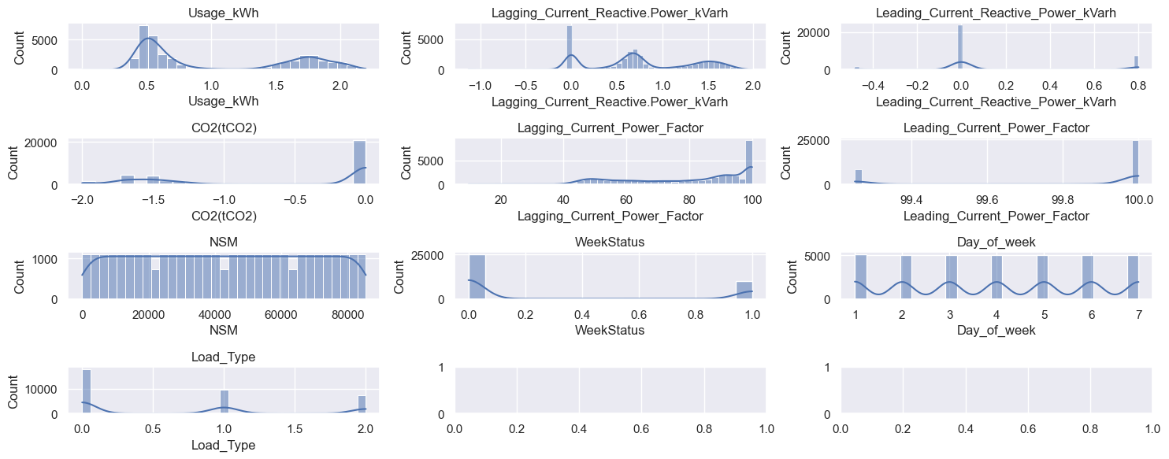
Important metrics: Total Distributions over features
After scaling relevant columns, we can see more balanced data across high-med-and low, more accurately representing important metrics

Slide 7
Important metrics: Pairplots
Many of the leading and lagging power factors have inverse relationships with each other and with other variables.
If it is feasible to collect this data it can be very powerful at predicting the kWh usage
The inverse relationship between Leading_current_reactive_power_kVarh and Leading current_power_factor is perhaps unexpected unless the nature of kVarh as used in the power consumption is understood. This implies significant waste in certain areas where kWh is used but kVarh is not used.

Slide 8
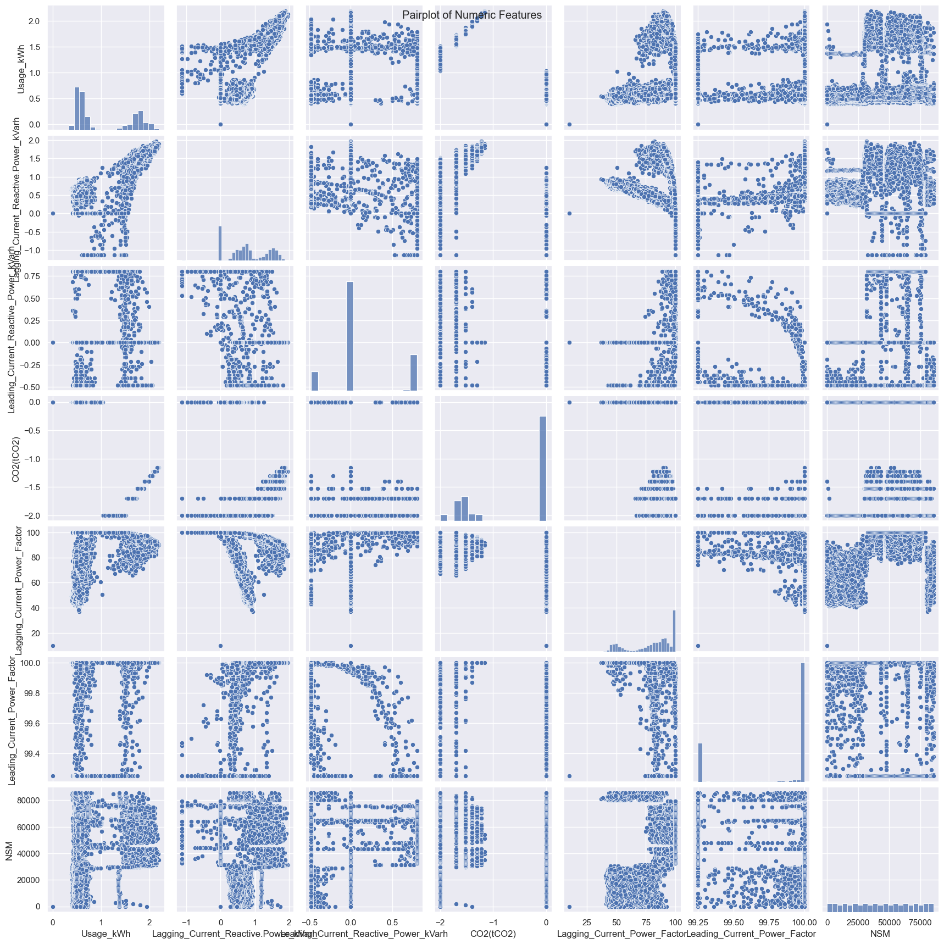

Slide 9
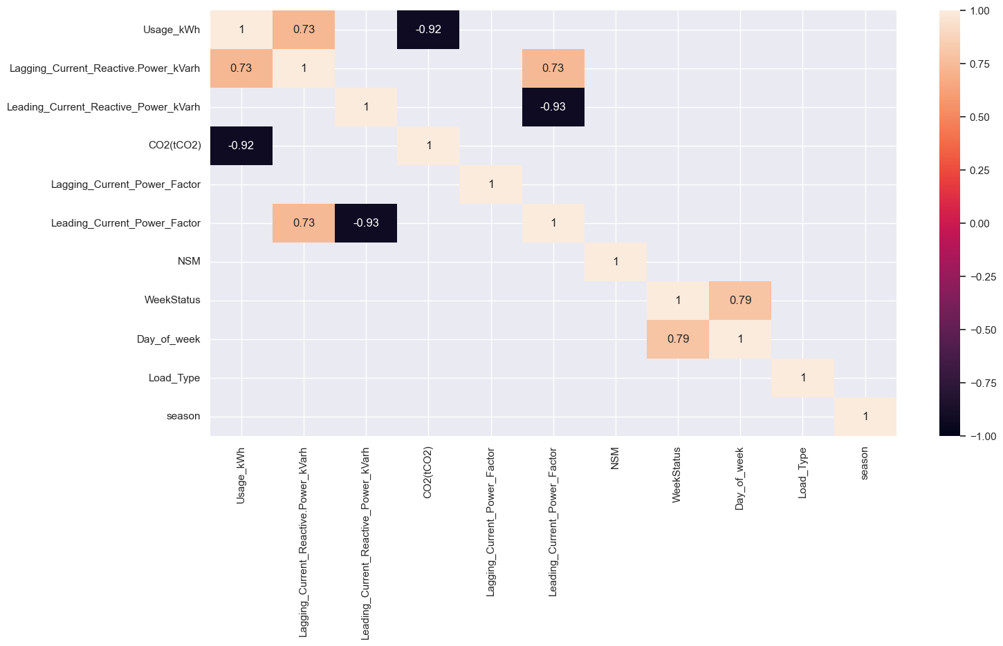
Important metrics: Corr Plot
CO2 can be almost a direct measure of kWh Usage, and can be a strong predictor

Slide 10
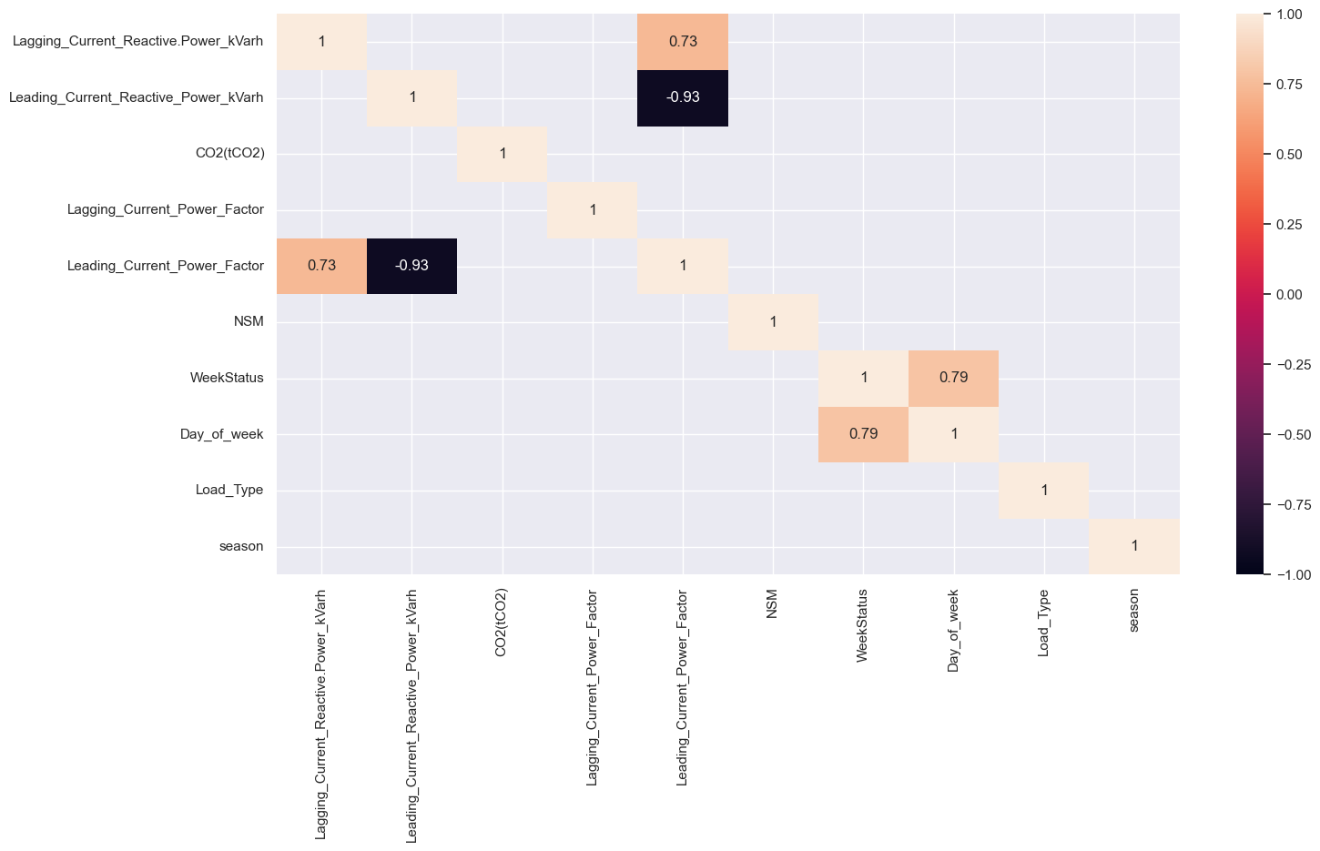
Important metrics: Corr Plot Regression on kWh
Leading Current Power factor is very highly correlated, thus not significantly informative and increases training time.

Slide 11
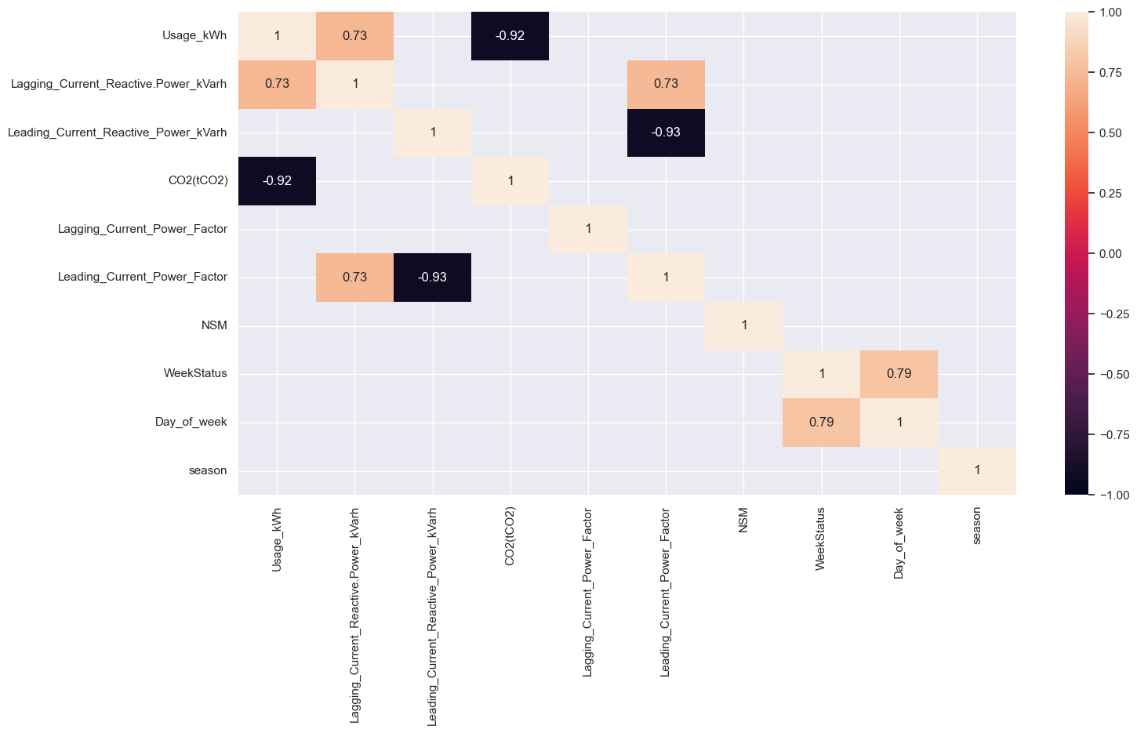
Important metrics: Corr Plot Classification on Load_Type
Same story with Leading Current Power Factor, as well as CO2 being highly correlated with kWh.
Important note: This may change in the future as companies switch to more solar.

Slide 12
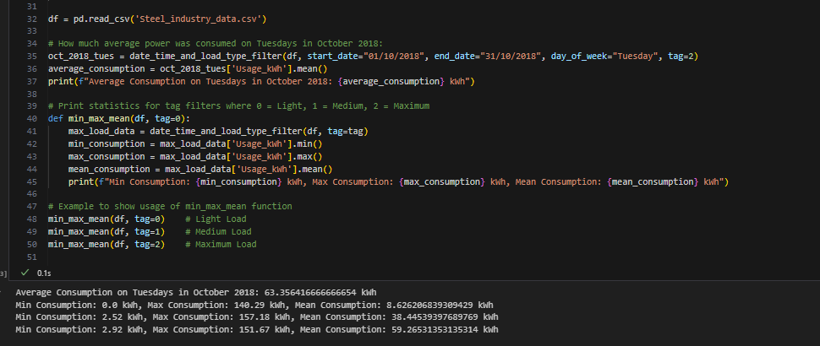
Important metrics: Total Distributions over features
Example code functionality to filter based on specified features

Slide 13
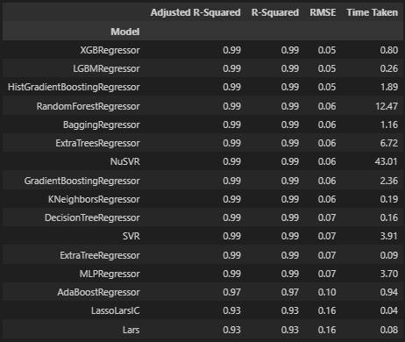
Important metrics: Regression assay: Root mean squared error and R squared metrics
The regression capabilities are extremely powerful, primarily due to the high correlations seen in the correlation plot between the other kwh metrics

Slide 14
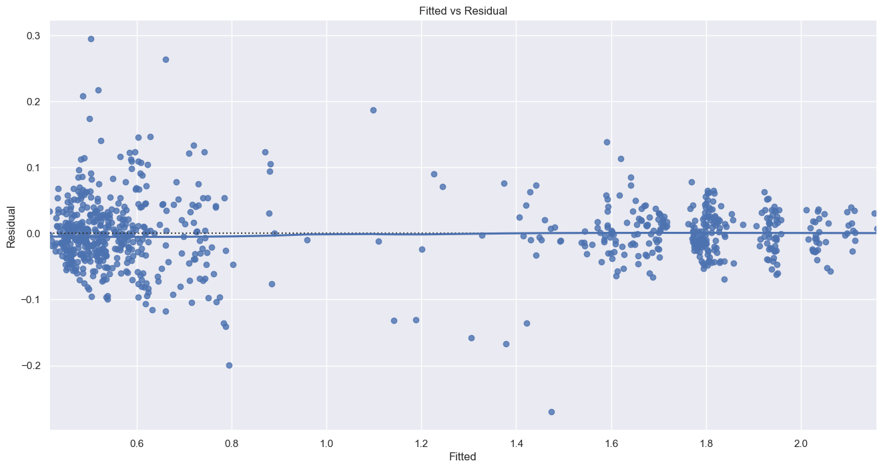
Final results:
Mean Squared Error: 0.00268
Very strong predictive capabilities but perhaps not realistic due to collection order of khw.
Either way predictive capability is strong if access to peripheral metrics is there.

Slide 15
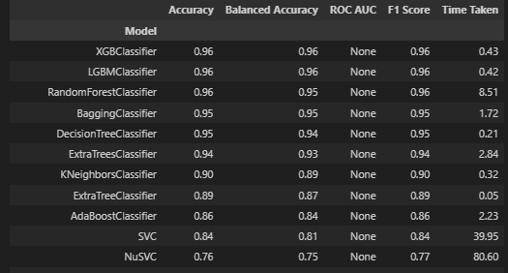
Important metrics: Classification assay:
XGBClassifier once again performs best
This is usually the case that both in regression and classification, the same classifiers and regressors succeed.
Load Type classification is consistently accurate for classification

Slide 16
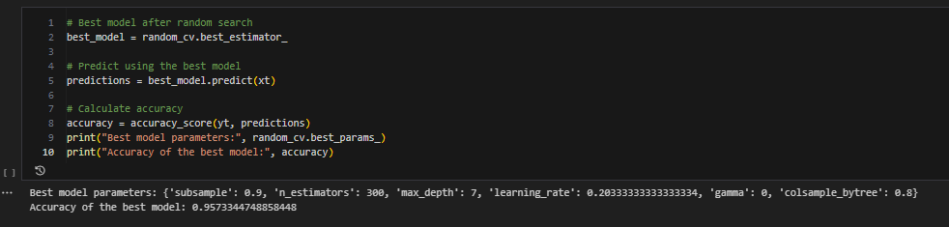
Classification Results:
Accuracy of the best model: 0.959189497716895

Slide 17
Important metrics: Total Distributions over features
Example code functionality to filter based on specified features

